Slide 1
Machine Learning Landscape
Michael Claudius, Associate Professor, Roskilde

Slide 2
What is Machine Learning
Machine Learning is the science (and art) of programming computers so they can learn from data.
Example Spam filter!: Task is to flag for spam.
Experience is the training data (E-mails).
Performance is the accuracy. E.G. 95% flagged correct.
Here is a slightly more general definition:
Machine Learning is the field of study that gives computers the ability to learn without being explicitly programmed. (Arthur Samuel, 1959)
And a more engineering-oriented one:
A computer program is said to learn from experience E with respect to some task T and some performance measure P, if its performance on T, as measured by P, improves with experience E. (Tom Mitchell, 1997)

Slide 3
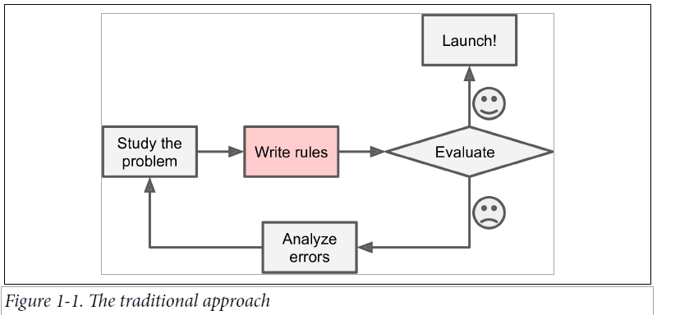
Machine Learning vs. Traditional Programming
Traditional programming
Write algorithm: Set up rules for words (For U, credit card, free)
Many rules => Complex algorithm
Spammer can work around rules (4U) => end-less number of rules

Slide 4
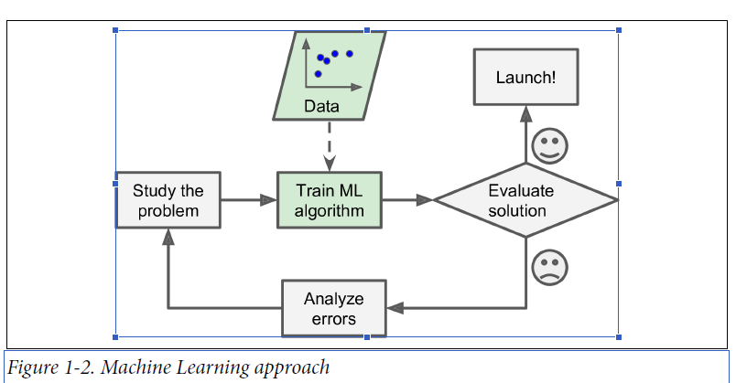
Machine Learning vs. Traditional Programming
Why Machine Learning
Learns automatically (from users flagging e-mails w; e.g. For U)
Short and easy to maintain

Slide 5
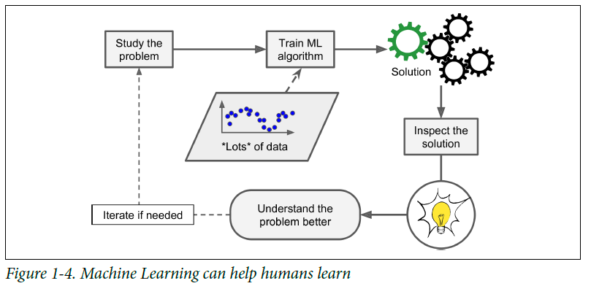
When Machine Learning
When to do Machine Learning
Complex algorithms
No known Algorithm (e.g. speech recognition)
Huge data. Data mining discover disguised patterns
Help humans to detect new trends or correlations

Slide 6
Examples of Machine Learning
Now discuss and find more areas where ML can be used !
Students answers:
Spam filters

Slide 7
Examples of Machine Learning
Now discuss and find more areas where ML can be used !
Students answers:
Spam
Traffic bottlenecks
Adverts based on customer patterns
Supermarkets shopping pattern
Amazon
Tesla self drivng cars
Speech recognition
Surveillance of persons
Gaming AI-cheating optimizing the shooting
Google-photos: face pictures
Diagnose of illness
YouTube choice selection
Searching algorithms
Robots, reinforcement learning
Statistical data, Clustering by K-means

Slide 8
Types of Machine Learning Systems
Human supervision or NOT
Supervised
Unsupervised
Semisupervised
Reinforcement learning
Online training (learn on the fly) vs. batch (NOT online)
Instance based (compare new data with old data) vs. Model based (build a predicative model)

Slide 9
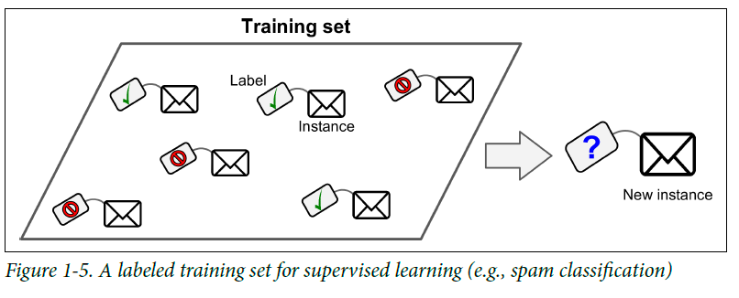
ML Supervised
Human supervision
Features have a label.
Classification (Spam or not spam)
(Linear) Regression (Car with the label price). Features of a car ??

Slide 10
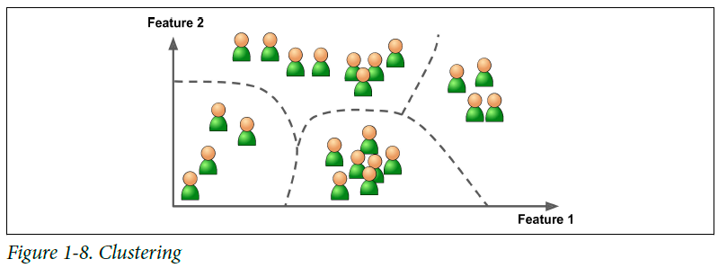
ML UnSupervised
No Human supervision
No labels.
Clustering (similar visitors to your blog/supermarket)
Not like Regression (Car with the label price)

Slide 11
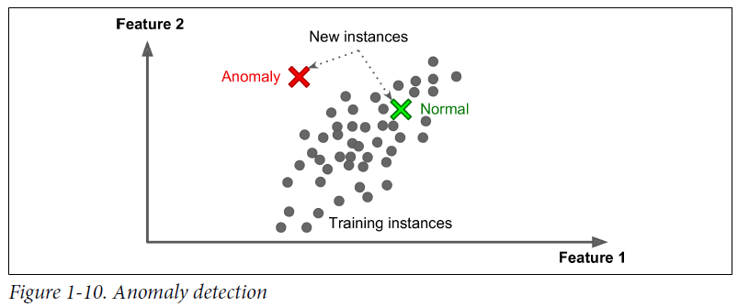
ML UnSupervised Annomaly detection
Credit transactions
Mobile call patterns

Slide 12
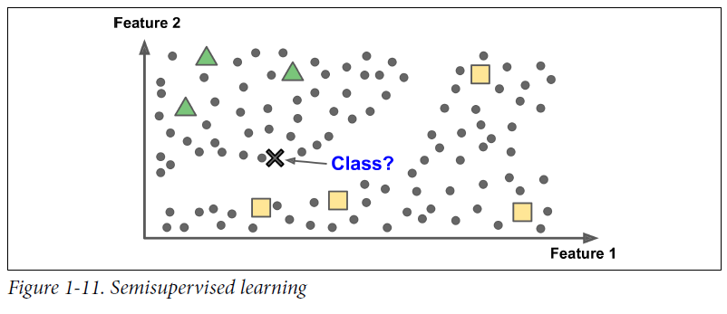
ML Semisupervised
Some (few) features have labels some NOT
Mixing learning from data with labels
Google photos !

Slide 13
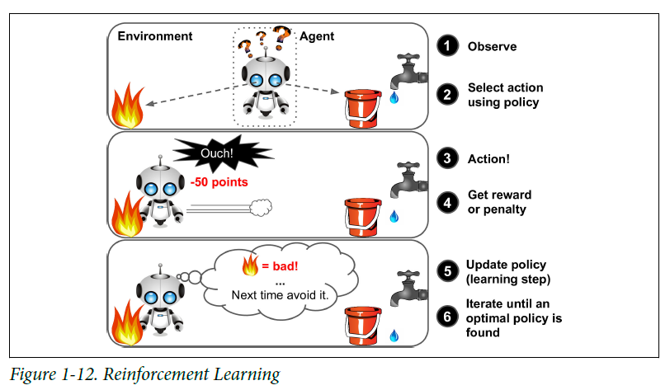
Reinforcement learning
Agent observes environment
Takes action
Reward or punishment

Slide 14
Batch learning
Train offline on available data set then launch
Advantage: Simple
Disadvantage: CPU-time, Cannot handle new data types
Cannot train a new system every day

Slide 15
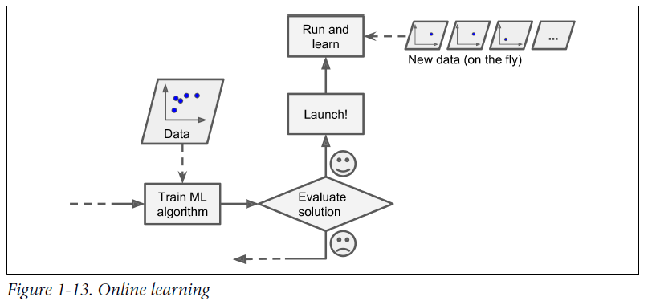
Online learning
Feed data in mini-batches -> Train -> Adapt to new data
Learning rate how fast should it learn ?
Advantage: Handle Continuous data flow. Handle Huge data
Disadvantage: Bad data can decline the performance. E.g. Bot attack or a malfunctioning sensor.

Slide 16
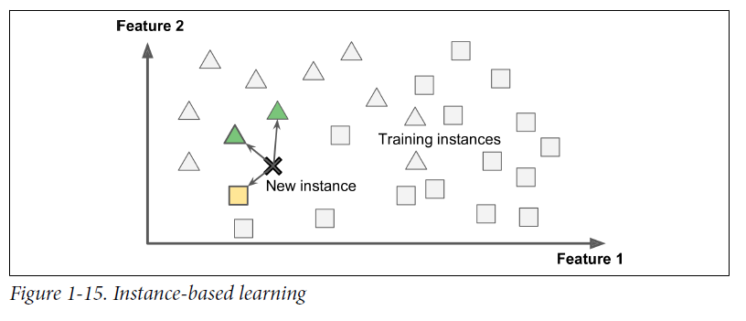
Instance based learning
Learn -> Use similarities to Generalize -> Make Predictions

Slide 17
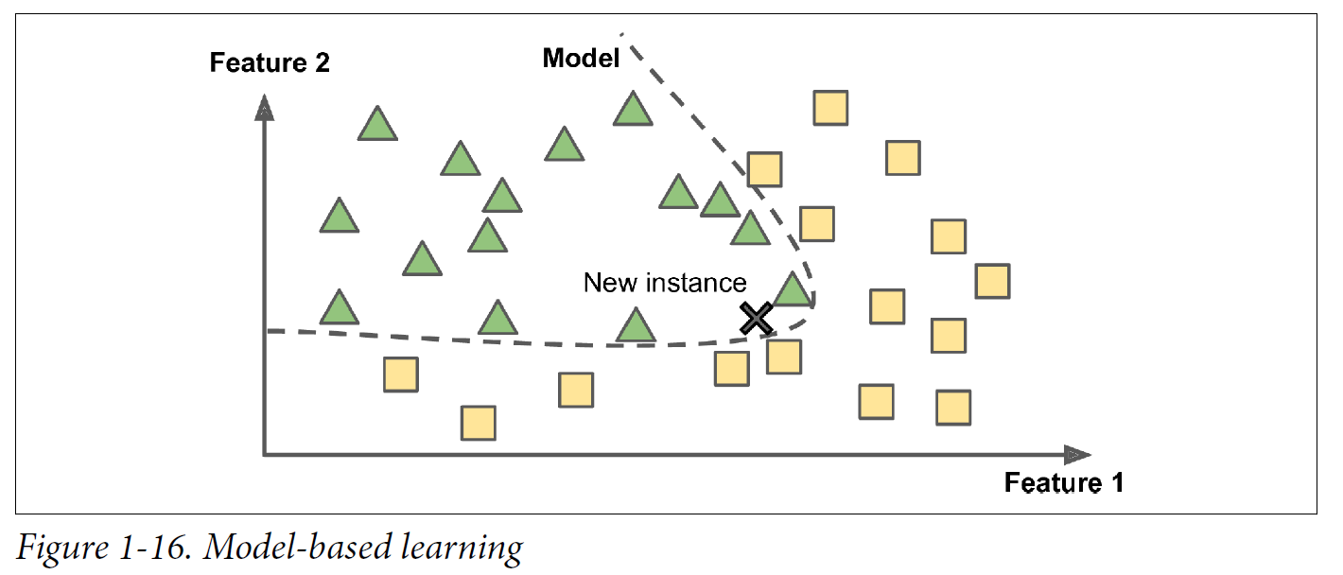
Model based learning: Classification
Learn by examples -> Build a model -> Make Predictions

Slide 18
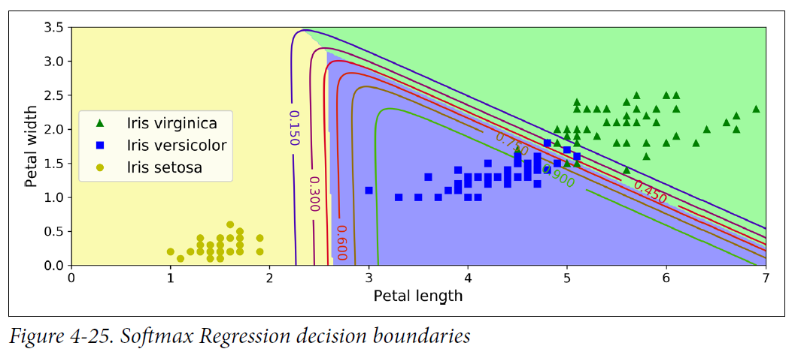
Iris: Probability plot with decision boundaries
Probability function using petal length and petal width and 3 classes
Notice the linear decision boundaries (e.g. green 90%probability) for Iris Versicolor

Slide 19
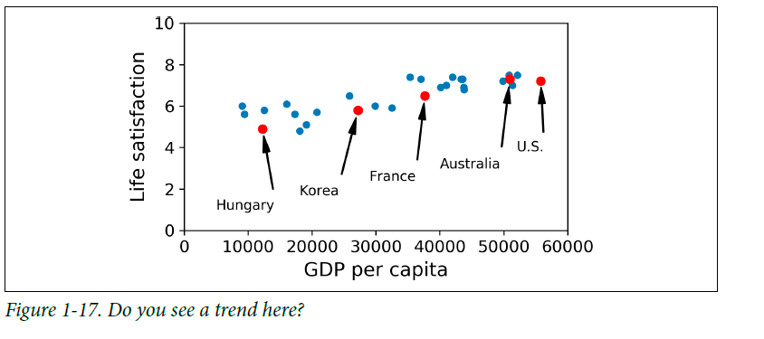
Model based learning. Regression
Learn by examples -> Build a model -> Make Predictions

Slide 20
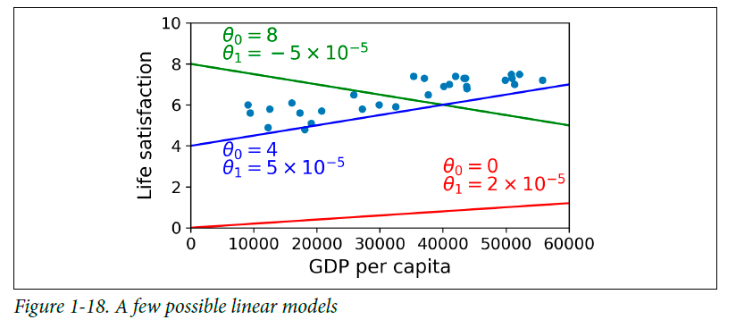
Model based learning. Regression
Find the best linear model: bx + a
θ₀ + θ₁xGDP

Slide 21
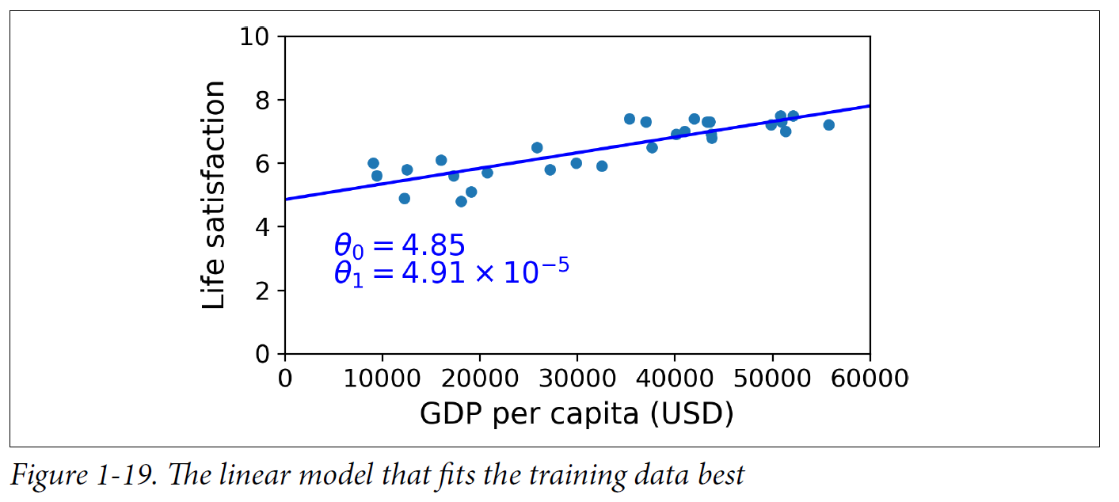
Model based learning. Regression
Find the best linear model: bx + a
θ₀ + θ₁xGDP

Slide 22
Regresison Code Example
Using ML to find the best linear model θ₀ + θ₁xGDP
Training and running the program !
Show and look at: Life satisfaction code !

Slide 23
Challenges of Machine Learning
Insufficient quantity of training data
Nonrepresentative training data
Poor quality data: outliners, noise, missing features for some data
Irrelevant features
Overfitting the training data
Underfitting the training data

Slide 24
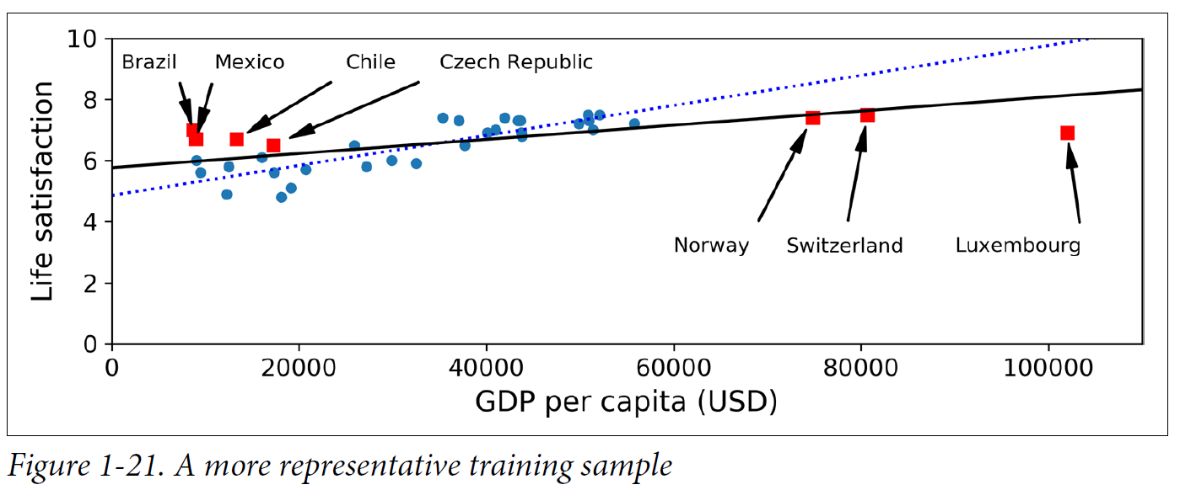
Nonrepresentative training data
Nonrepresentative data leads to a model with low accuracy for some data

Slide 25
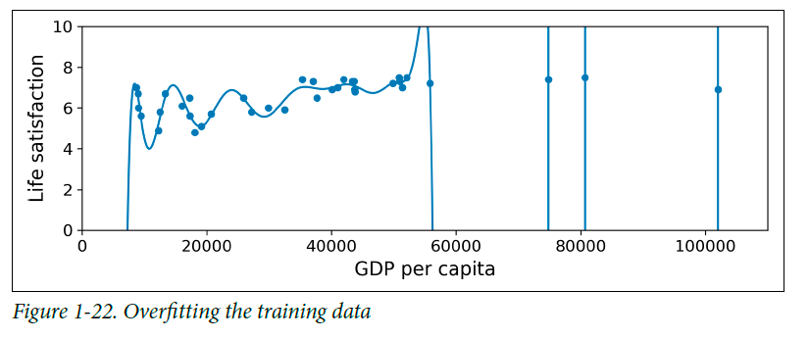
Overfitting
Making the model too good on training set.
But low accuracy for other test data
Solution: use a more simple model and regularization

Slide 26
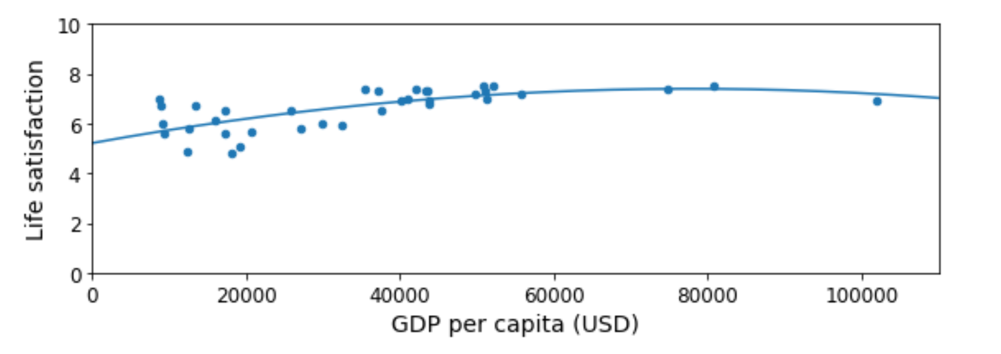
Overfitting solution
Making the model better on training set.
And hiogh accuracy for other test data
Solution: use a more simple model and regularization like degree = 2

Slide 27
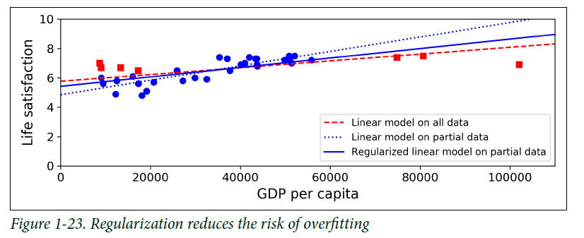
Regularization
Setting constraints on the model parameters

Slide 28
Underfitting
Too simple model to find a structure in the data
Solution: Model with more parameters
Better features
Remove any constraints and regularization

Slide 29
Testing and validation
Split data set into training set and a test set
Train model on training set (80%-90% data)
Finally test finally model on test set (10%-20% data)

Slide 30
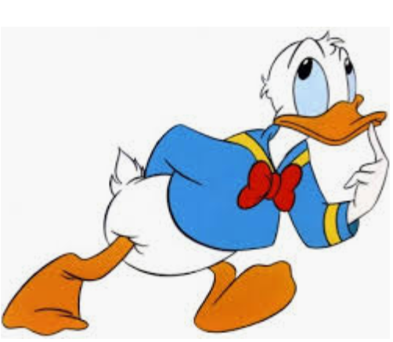
Exercise
It is time for discussion, setting up the environment Anaconda and coding Python in Spyder !
Chapter 1 Assignments: No. 1 - 14
Anaconda Installation Guide
Jupiter Test
Python Basic No. 1

